Slide 1
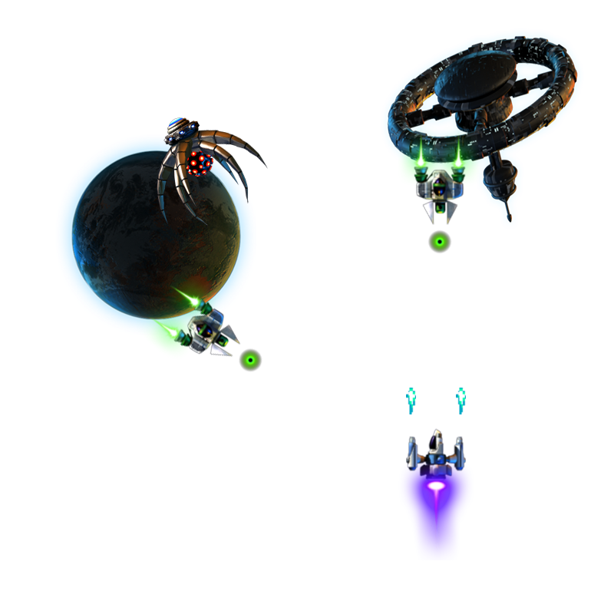
Collider

Slide 2
INTRODUCTION
Original idea – asteroids and meteoroids colliding with each other…
Why did I change it?
I felt like the original idea was too basic and that I needed to make the game more interesting
Since I decided to use the Unity Engine, I felt like I could add more complexity to my game, i.e. different enemies with different behaviours.
If I wanted people to enjoy my game, it’s important that the enemies displayed at least some level of intelligence.

Slide 3
The new IDEA
Collider is an online 2-D space shooting game.
The objective of the player is to battle and destroy incoming enemy ships.
The player will have health points and can collect hearts to regain health.
The game has features such as collision detection, dynamic difficulty adjustment, and an online database where players will be ranked based on their scores.

Slide 4
Motivation
My love for games is what actually got me interested in computer science.
I had a very basic knowledge of how games were developed.
I really enjoy independent learning and the course did not teach game development to us as a module. So, my goal was to do a project that would allow me to develop and understand game development.

Slide 5
WHY DID I USE THE UNITY ENGINE?
I used the Unity Engine because:
I wanted the GUI for the game to be well designed and the Unity Engine was best suited for that.
I wanted the game to have animations and sprites. Doing this with Unity saves time so that I can focus on the more important aspects of the project.

Slide 6
Design
When designing the game I wanted to ensure that:
The user interface was designed to a high standard and easy to use.
It was built in a way that I could easily add new features to my game. For example, new enemies and sound.
It was lag free.
It was playable and that the difficulty level was at an intermediate level.
I showed both my programming skills and non-programming skills (e.g. photo editing skills).

Slide 7
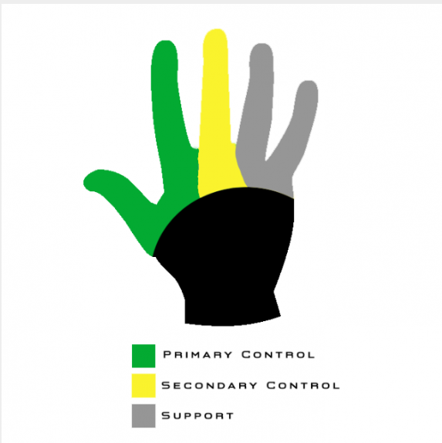
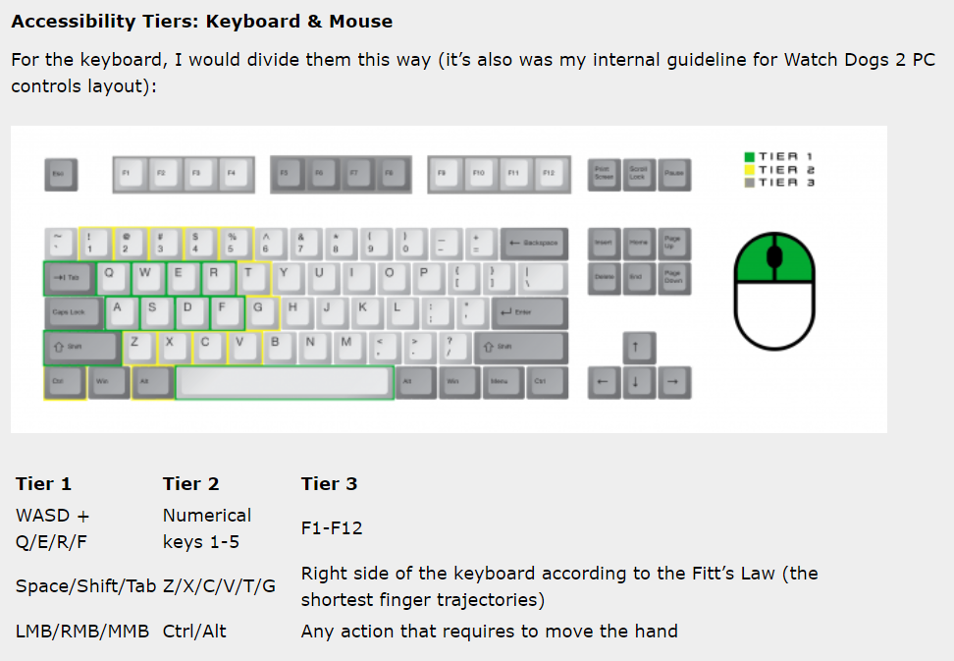
User Interface
The controls for the game were based on Fitts’s Law.
Fitts’s Law – is a predictive model of human movement primarily used in human-computer interaction and ergonomics.
WASD or Arrow keys to move.
Space bar to fire missiles.
Escape button to pause.

Slide 8
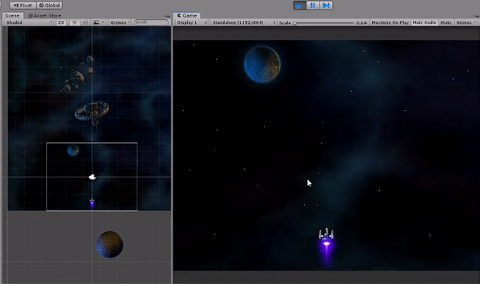
Space theme
I wanted the player to feel as if they were really travelling through space.
The game consists of a moving background, planets, space rocks, and stars.
I implemented this using Object Pooling.
Object Pooling – is when you reuse objects that have been already instantiated before gameplay, rather than allocating and destroying them.

Slide 9
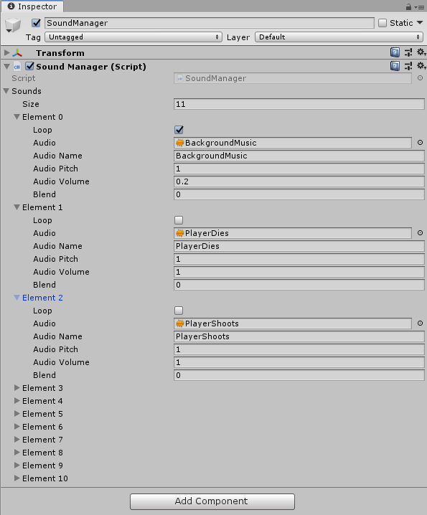
Custom Sound manager
I added a custom sound manager component which allowed me to easily add sound to the game.
Unity has an audio source component which allows you to add sound to your game. Using this component is very inefficient.
It requires you to add sound on a per object basis.
There could be hundreds of objects in a game. So, doing it this way would obviously be very time consuming.

Slide 10
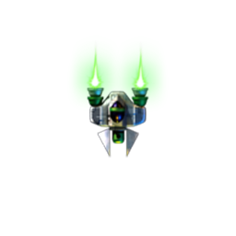

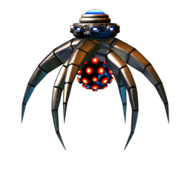
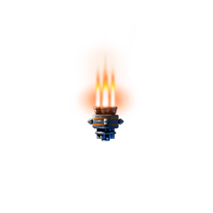
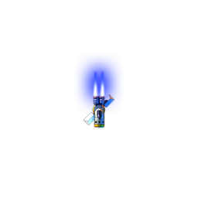

Enemies and collectables
There are 5 enemy ships in total.
4 normal enemy ships.
1 mother ship, which is the boss.
The player can pick up hearts to regain HP.
All enemies will display some level of intelligence.
Each enemy has health points and all of them behave differently to each other.
They all spawn into the world based on the players position.
Notes:
In Slide Show mode, select the arrows to visit links.

Slide 11
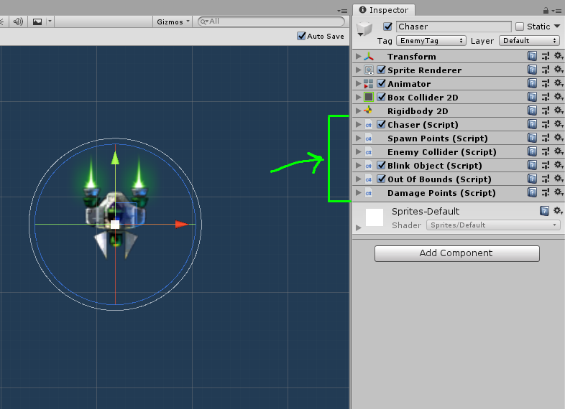
polymorphism
In order to showcase the power of Unity, I wanted to show some form of polymorphism using the Unity Engine.
I wanted the enemies to have a set of core components that they all have attached to their game object.
Having the enemies use a set of core specific components allowed me to easily add new enemies.
Some of these components are reusable for other objects.

Slide 12
Spawn manager
The spawn manager will spawn objects based on the players position.
The objects that are added to the spawn manager are weighted.
To implement this, I used the Cumulative Distribution Function.
The weights are re-adjusted based on the players performance.
Why I spawn objects based on the players position:
It makes the game more interesting.
To give the player an advantage.
To add more difficulty.

Slide 13
Data driven development
TDD is good for testing the logic of your program, but in game design it loses value when we try to make things progress over time.
This is because each time we move forward with the development of the game, we’re constantly iterating, and the design is changing as the game evolves and progresses.
DDD allows me to get actual data out of those tests to make my design and game better.
Types of tests done in DDD
Tests to validate the behaviour of the game objects with their components attached.
Unit Testing
Integration Testing
Interface Testing
User Acceptance Testing

Slide 14
User Interface testing
Visibility – I made sure that when any scene in my game was loaded, its respective components were present, and that components expected to be active in the hierarchy, were active.
Consistency – I wrote tests to ensure that when buttons were clicked, they performed the right actions.
Usability – I ensured that all buttons present in the scenes were interactable and displayed the correct text.
Very important. It involves assessing the UI based on important variables such as:
Visibility
Consistency
Usability

Slide 15
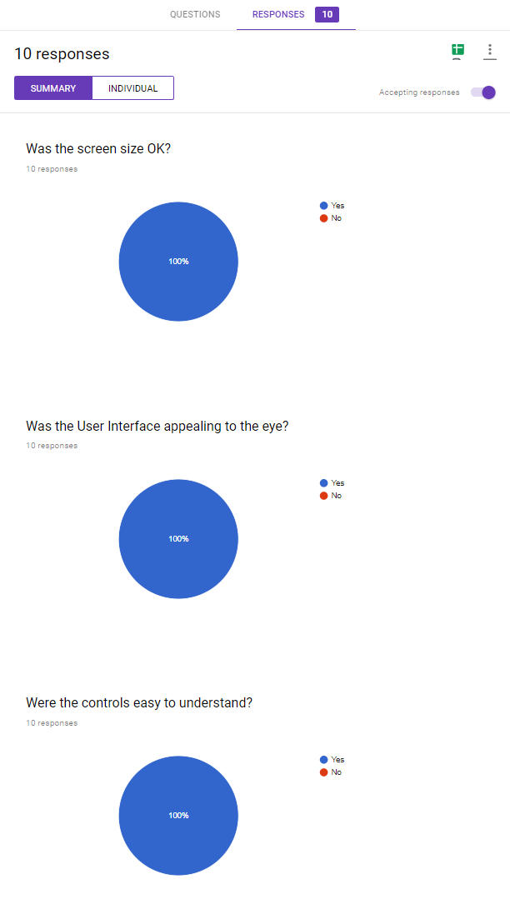
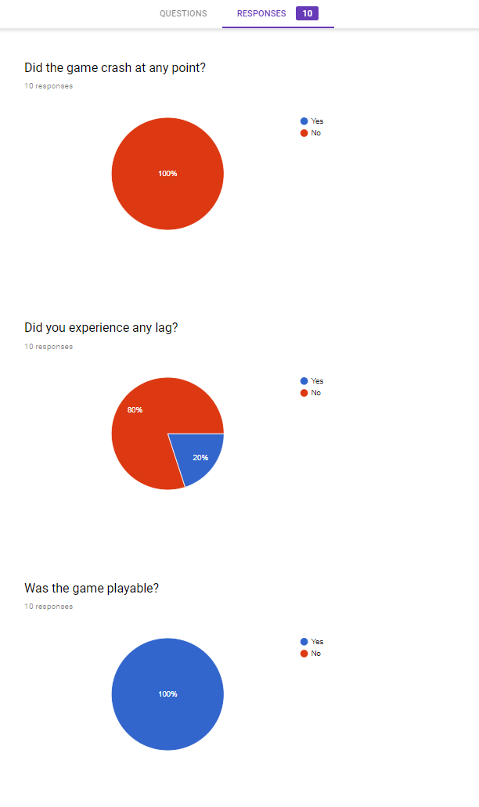
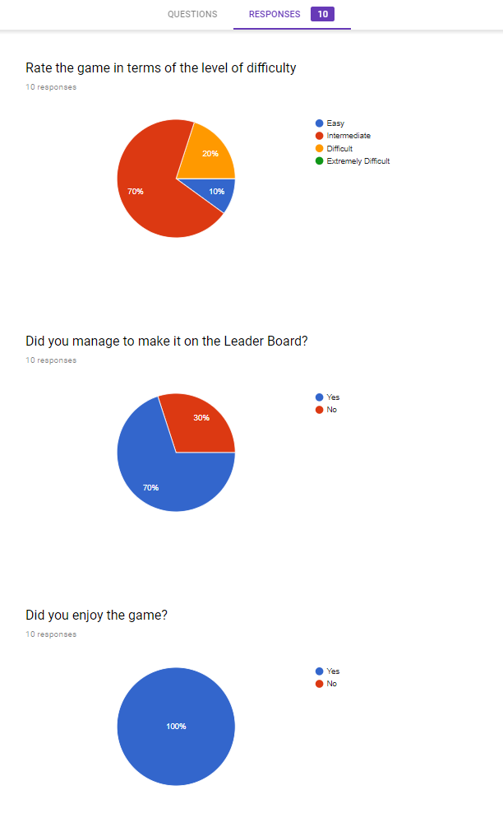
User acceptance testing

Slide 16
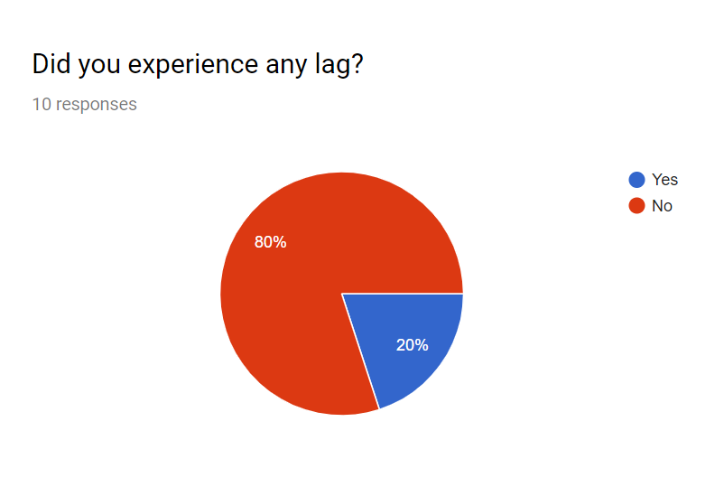
optimization
Methods to reduce lag:
Object Pooling
Static Batching – allows the engine to reduce draw calls for geometry of any size provided that it shares the same material and does not move.
Player Reloading

Slide 17
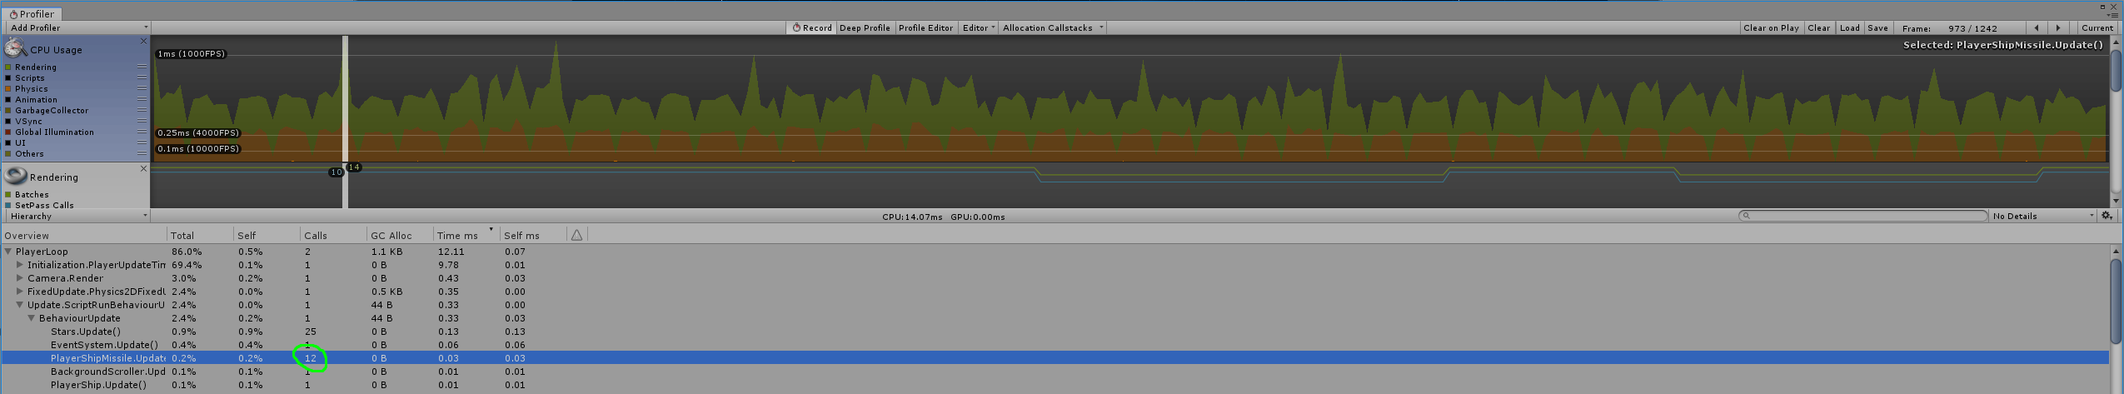
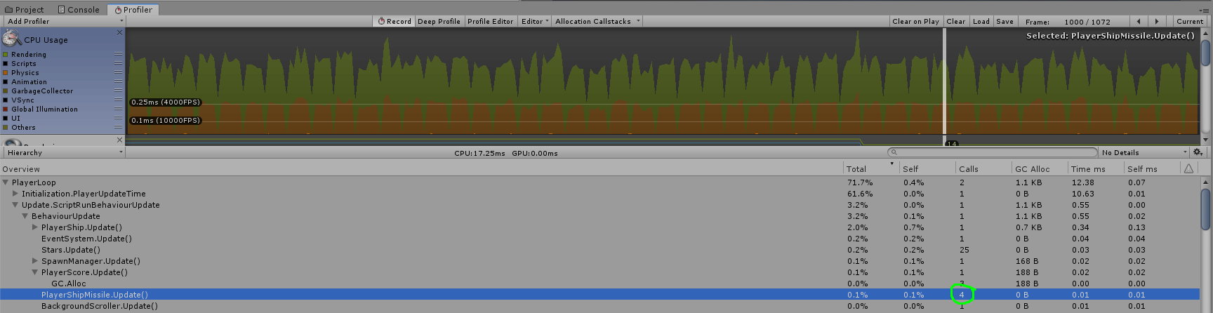
optimization

